Slide 1
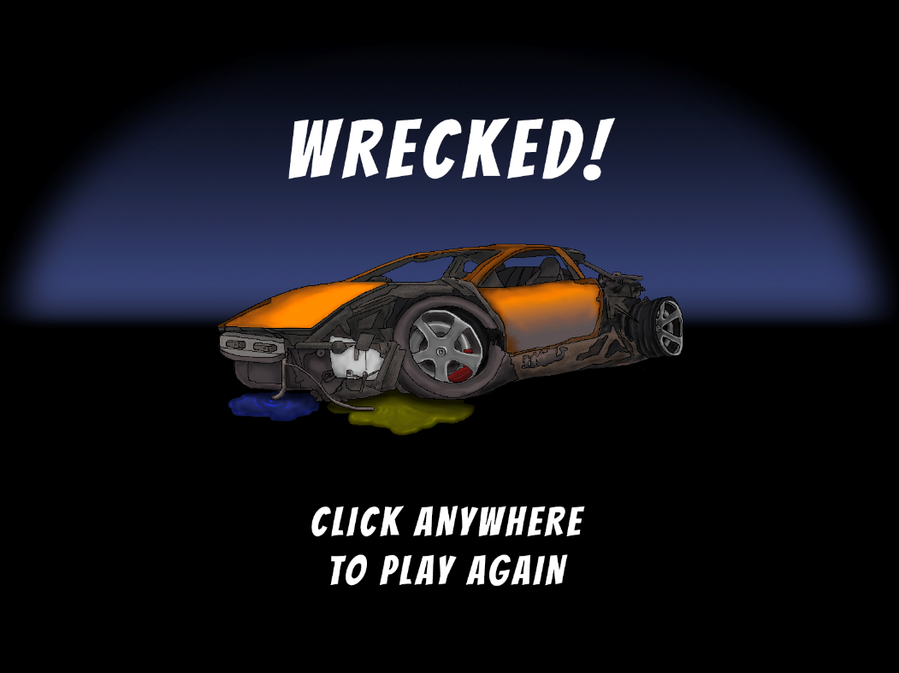
Little Racers
Pitch Date: June 22 , 2019 Week 12: 9/15/2019
Release Date: September 15, 2019 Release Day!
Team Lead: Vince McKeown
21 contributors
445 total commits!

Slide 2
Updates
Vince McKeown
Constrained Race time, fixed bugs,
Christer “McFunky Pants” Kaitila
Optimized fire particle efftcs
Fixed Start positions
Fixed Collision Systems
Created New Map
Many fixed and tweaks! (12 in a row!)
Jeff Hanlon
Added all new art for the Vehicle Upgrade Page
Chris Deleon
Added Credits, Tweaked Car Start Position

Slide 3
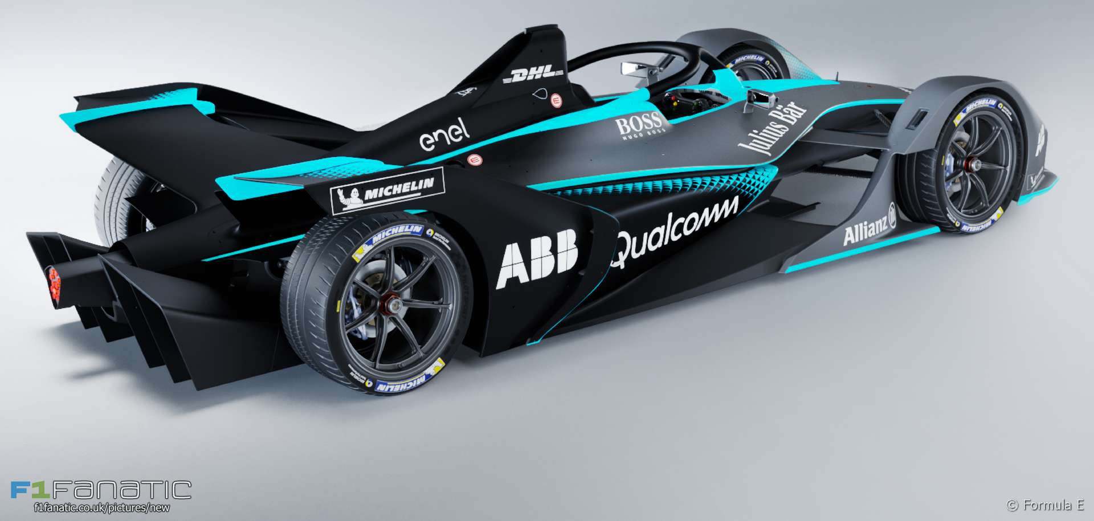
Demo
Cutover to Game

